Slide 1
Deep Neural Networks for Artistic Style Transfer
Zhenyang Xu
Email: deanxu@seas.upenn.edu
CIS-5810 Computer Vision Final Project Report
University of Pennsylvania, Philadelphia, PA 19104

Slide 2
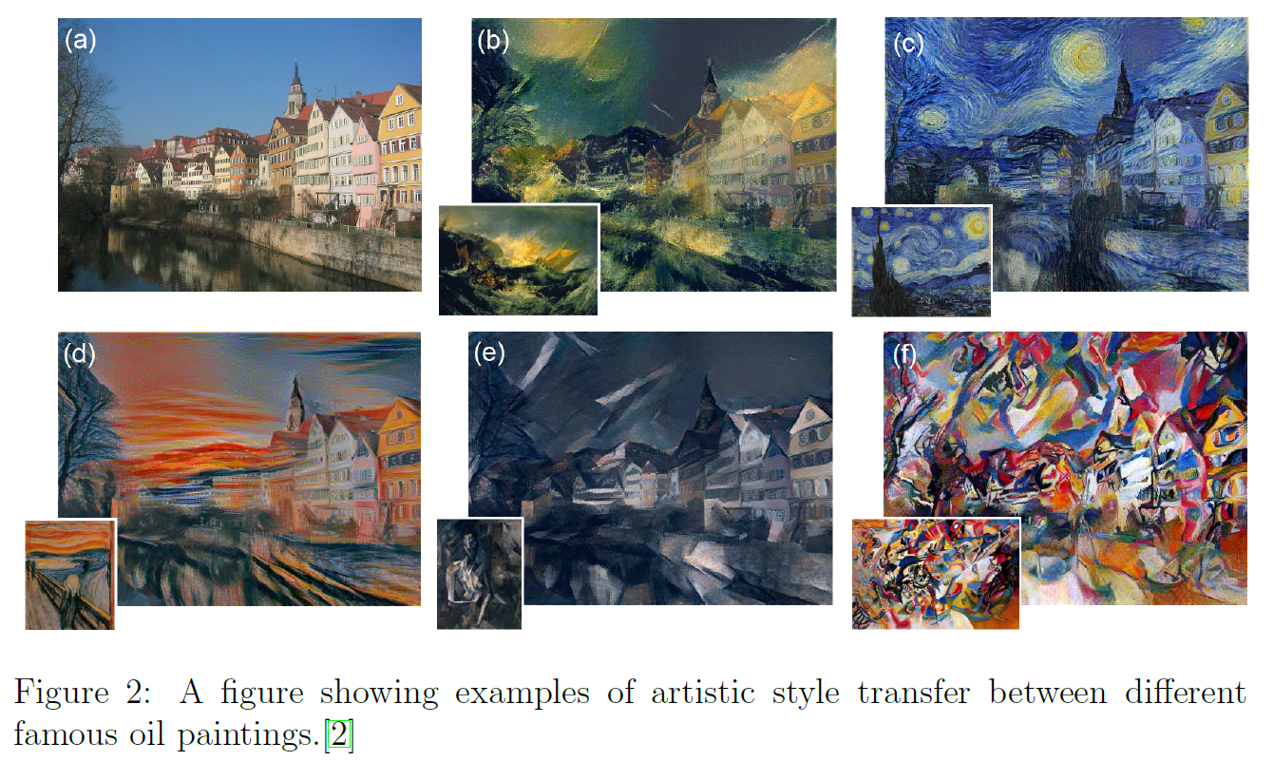
What is Artistic Style Transfer?

Slide 3
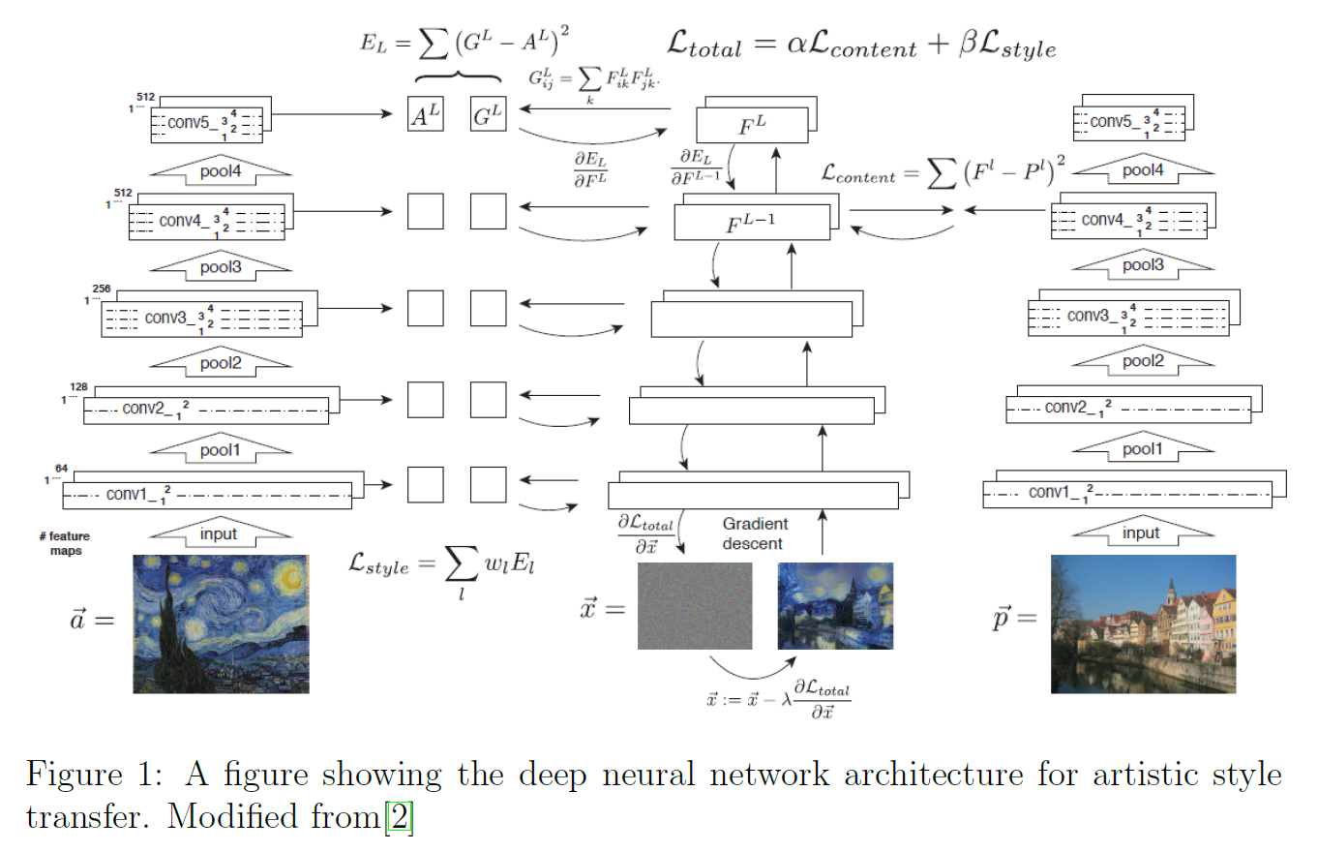
What Deep Neural Network (DNN) to use?

Slide 4
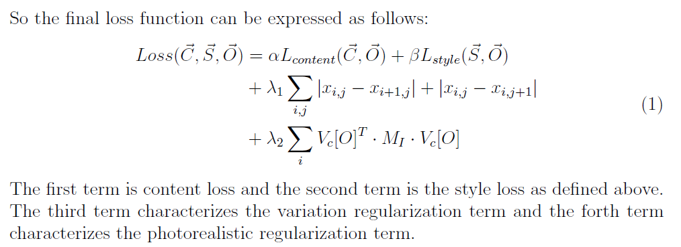
Which Objective / Loss Function to use?

Slide 5
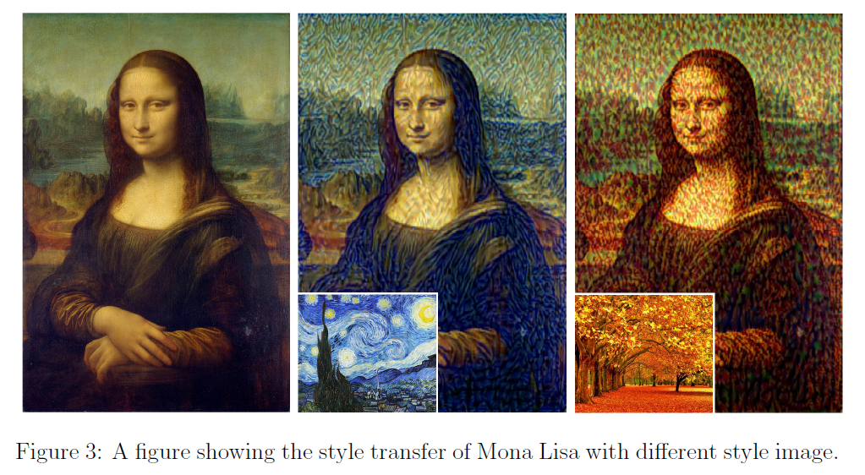
Some Preliminary Results:

Slide 6
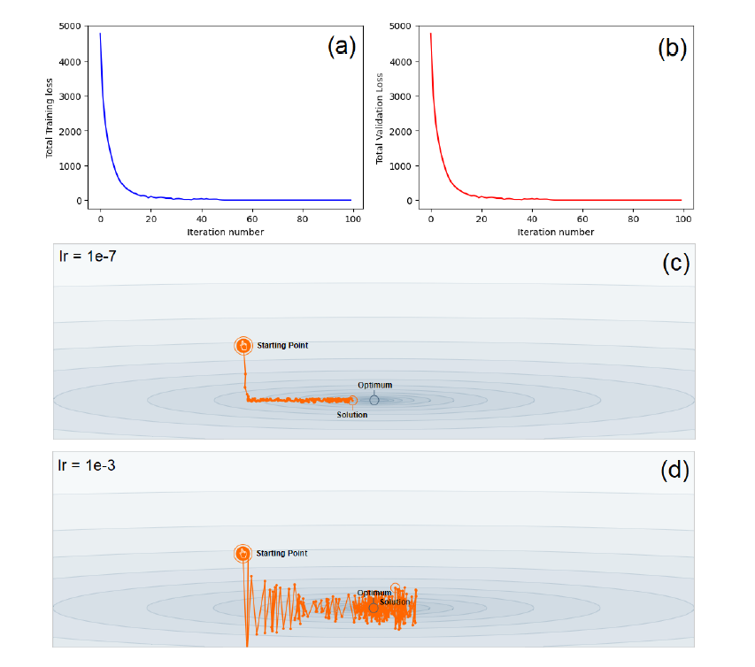
Training Phase:

Slide 7
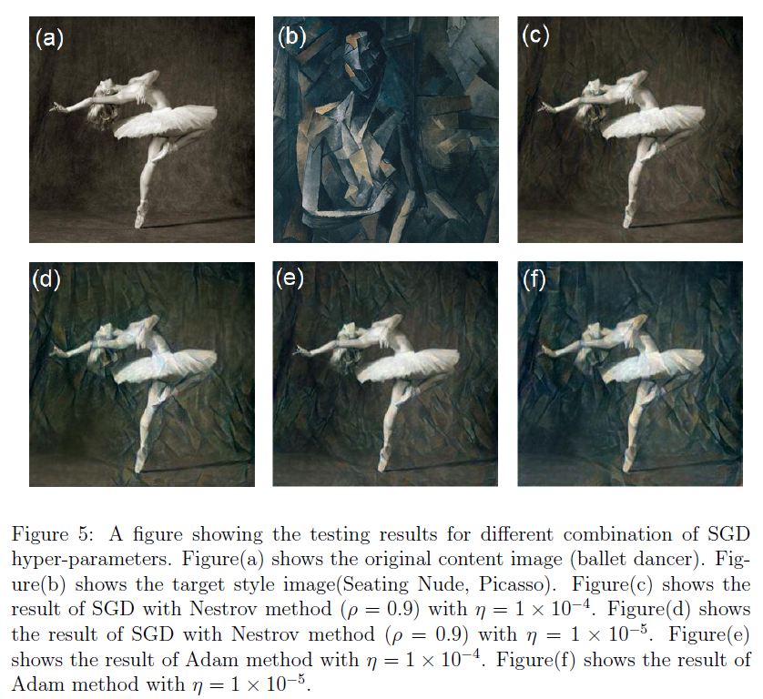
Experiment Different GD Algorithms:

Slide 8
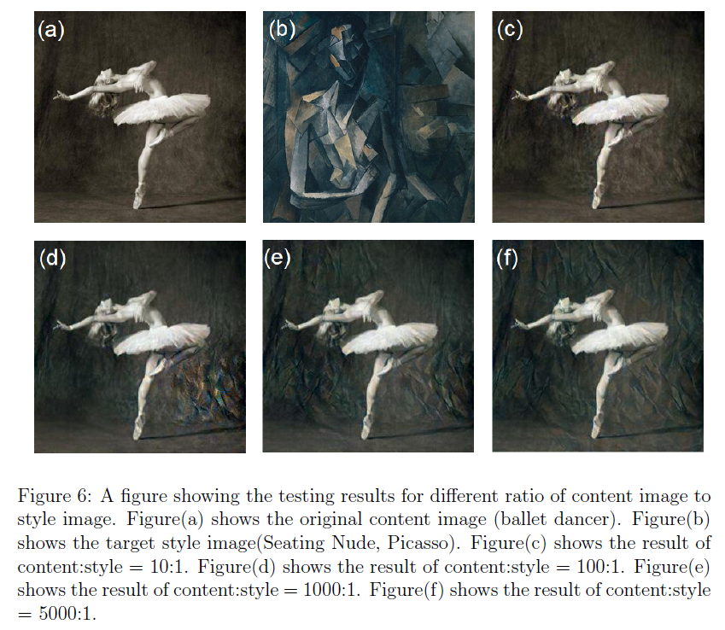
Experiment Different Ratio Parameters:

Slide 9
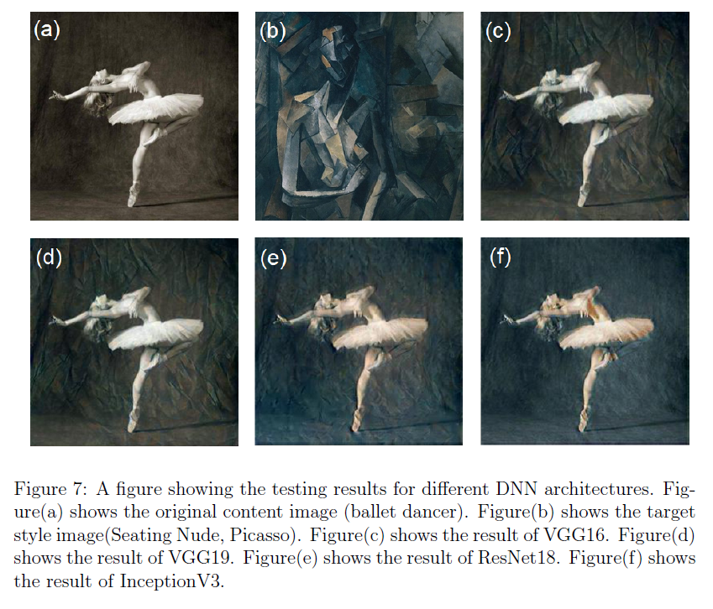
Experiment Different DNN Architectures:

Slide 10
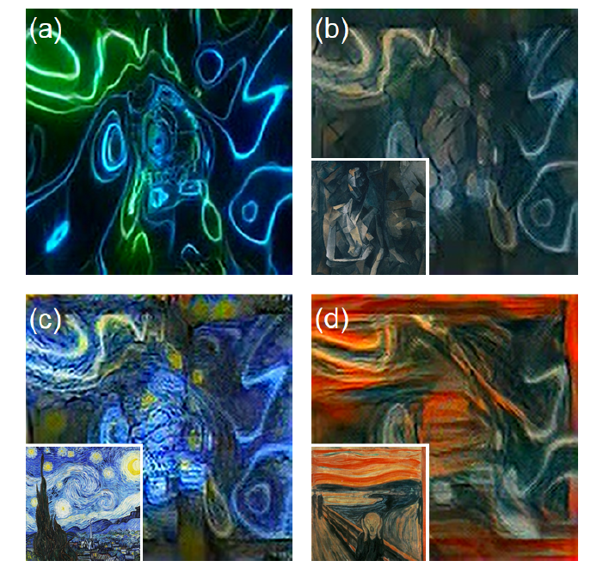
Video Style Transfer:

Slide 11
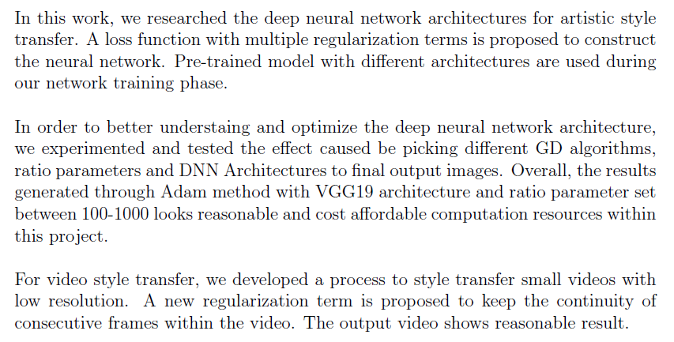
Conclusion:

Slide 12
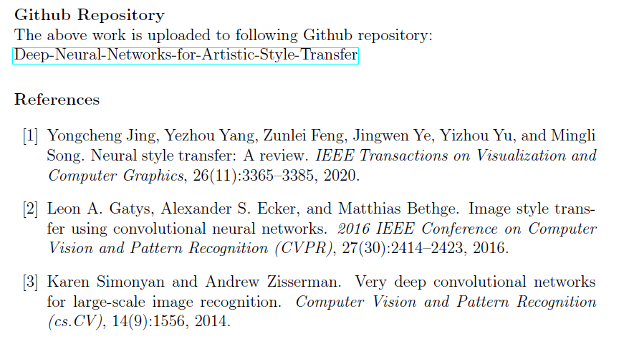
Acknowledgements:

